Slide 1
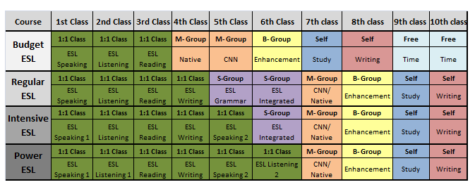

Slide 2
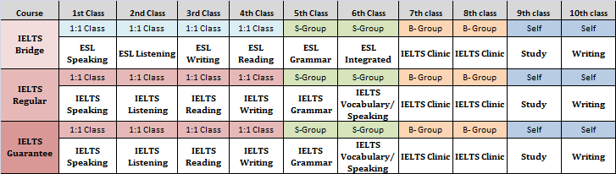

Slide 3
TOEIC BRIDGE
07:20 ~ 08:20 | ESL DAILY TEST
08:30 ~ 09:20 | One on One (1:1) | ESL LISTENING
09:25 ~ 10:15 |  | ESL READING
10:20 ~ 11:10 |  | ESL SPEAKING
11:15 ~ 12:05 |  | ESL WRITING
12:05 ~ 13:05 | LUNCH
13:05 ~ 13:55 | Small Group Class | ESL Grammar
14:00 ~ 14:50 |  | ESL Speaking
14:55 ~ 15:45 | Big Group Class | TOEIC Clinic
15:50 ~ 16:40
16:45 ~ 17:35 | Self-Study
 | DINNER
TOEIC GUARANTEED 600/700/850
07:20 ~ 08:20 | TOEIC DAILY TEST
08:30 ~ 09:20 | One on One (1:1) | TOEIC LISTENING
09:25 ~ 10:15 |  | TOEIC SPEAKING
10:20 ~ 11:10 |  | TOEIC READING (Part 5/6)
11:15 ~ 12:05 |  | TOEIC READING (Part 7)
12:05 ~ 13:05 | LUNCH
13:05 ~ 13:55 | Small Group Class | TOEIC Grammar
14:00 ~ 14:50 |  | TOEIC Vocabulary
14:55 ~ 15:45 | Big Group Class | TOEIC Clinic
15:50 ~ 16:40
16:45 ~ 17:35 | Self-Study
 | DINNER

Slide 4


Slide 5
CURRICULUM SCHEDULE BUSINESS
BEGINNER - PRE-INTERMEDIATE
Class | Book | Skills Focused | Teacher | Period
1:1 | Business Vocabulary Elementary | Vocabulary/Reading | Teacher 1 | Any
1:1 | Business Grammar | Grammar | Teacher 2 | Any
1:1 | Business Result Elem/Pre-Inter | Reading/Listening/Speaking | Teacher 3 | Any
1:1 |  |  | Teacher 4 | Any
1:1 | Email English | Writing | Teacher 5 | Any
1:4 | Fundamentals of Business | All Skills | Group Teacher | Any
1:4 | CNN/NATIVE | All Skills | Group Teacher | Any
Activity | Presentation/Business English | All Skills | Activity Teacher | 2nd/3rd
INTERMEDIATE - UPPER INTERMEDIATE
Class | Book | Skills Focused | Teacher | Period
1:1 | Business Vocabulary Intermediate | Vocabulary/Reading | Teacher 1 | Any
1:1 | Business Grammar | Grammar | Teacher 2 | Any
1:1 | Business Result Intermediate/Upper-Inter | Reading/Listening/Speaking | Teacher 3 | Any
1:1 |  |  | Teacher 4 | Any
1:1 | Email English | Writing | Teacher 5 | Any
1:4 | Fundamentals of Business | All Skills | Group Teacher | Any
1:4 | CNN/NATIVE | All Skills | Group Teacher | Any
Activity | Presentation/Business English | All Skills | Activity Teacher | 2nd/4th

